Slide 1
Flutter.io
Paetow Rolf, Dominik Seifert

Slide 2
Das (geistige) Vorbild: React (native)
Parallelen:
State
Responsiveness
Multiplattform
Nutzt nativen code „You can expect excellent performance. Flutter is designed to help developers easily achieve a constant 60fps. Flutter apps run via natively compiled code – no interpreters are involved. This means Flutter apps start quickly.“
https://flutter.io/faq/#what-kind-of-app-performance-can-i-expect

Slide 3
Was macht Flutter anders?
Facebook mit React: It’s worth noting that we’re not chasing “write once, run anywhere.” Different platforms have different looks, feels, and capabilities, and as such, we should still be developing discrete apps for each platform, but the same set of engineers should be able to build applications for whatever platform they choose, without needing to learn a fundamentally different set of technologies for each. We call this approach “learn once, write anywhere.” – Tom Occhino¹
Google mit Flutter: “Write once, run anywhere”.
¹ https://code.facebook.com/posts/1014532261909640/react-native-bringing-modern-web-techniques-to-mobile/

Slide 4
Vorraussetzungen
Mac/Windows/Linux
Git (command line tools)
Flutter SDK
Android Studio/XCode
Android Emulator/Device od. iOS Simulator/Device
Visual Studio Code od. Intelli J Idea.
Grundkenntnisse im Umgang mit Dart.

Slide 5
Google Dart
Entwickelt als JavaScript Alternative
Objektorientiert (Klassen, Interfaces, Vererbung), optional Typsicher
Lässt sich zu JavaScript umwandeln
Jede Dart Datei hat seinen isolierten state/scope.
Dart:
elem.query('#foo'); elem.queryAll('.foo');
JavaScript:
getElementsById(), getElementsByTagName(), getElementsByName(), getElementsByClassName(), querySelector(), querySelectorAll(), document.links, document.images, document.forms, document.scripts, formElement.elements, selectElement.options...

Slide 6
Google Dart - Why did Flutter choose to use Dart?
Developer productivity. One of Flutter’s main value propositions is that it saves engineering resources by letting developers create apps for both iOS and Android with the same codebase. Using a highly productive language accelerates developers further and makes Flutter more attractive.
Object-orientation. For Flutter, we want a language that’s suited to Flutter’s problem domain: creating visual user experiences. The industry has multiple decades of experience building user interface frameworks in object-oriented languages. While we could use a non-object-oriented language, this would mean reinventing the wheel to solve several hard problems.
Predictable, high performance. With Flutter, we want to empower developers to create fast, fluid user experiences. In order to achieve that, we need to be able to run a significant amount of end-developer code during every animation frame. That means we need a language that both delivers high performance and delivers predictable performance, without periodic pauses that would cause dropped frames.
Fast allocation. The Flutter framework uses a functional-reactive style programming model, whose performance depends heavily on the underlying memory allocator efficiently handling small, short-lived allocations. The functional-reactive style was developed in languages with this property and does not work efficiently in languages that lack this facility.
https://flutter.io/faq/#what-kind-of-app-performance-can-i-expect
Notes:
VULKAN

Slide 7
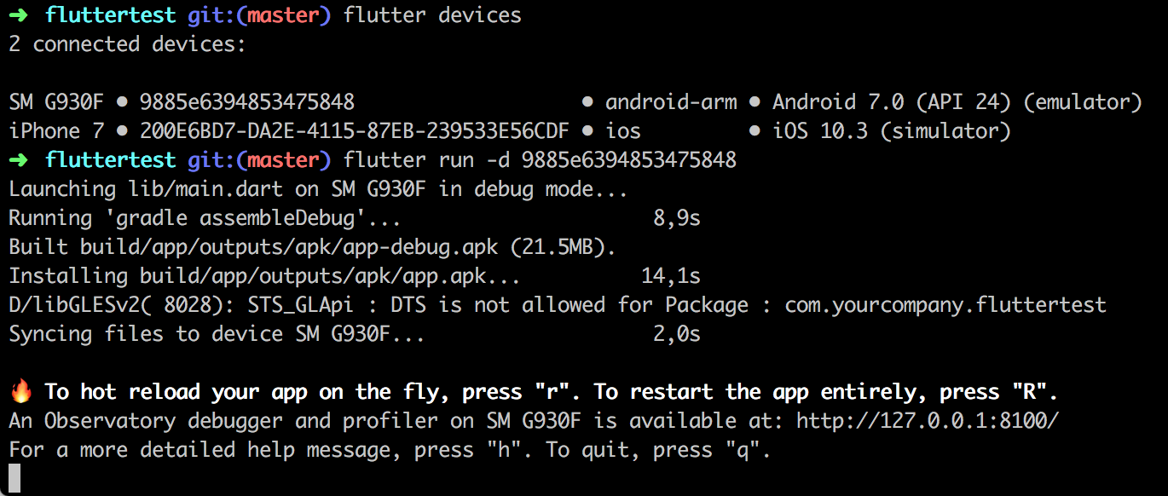
Workflow
flutter create myapp (and cd to newly created folder)
(flutter devices)
flutter run (-d <device id>)

Slide 8
Features

Slide 9
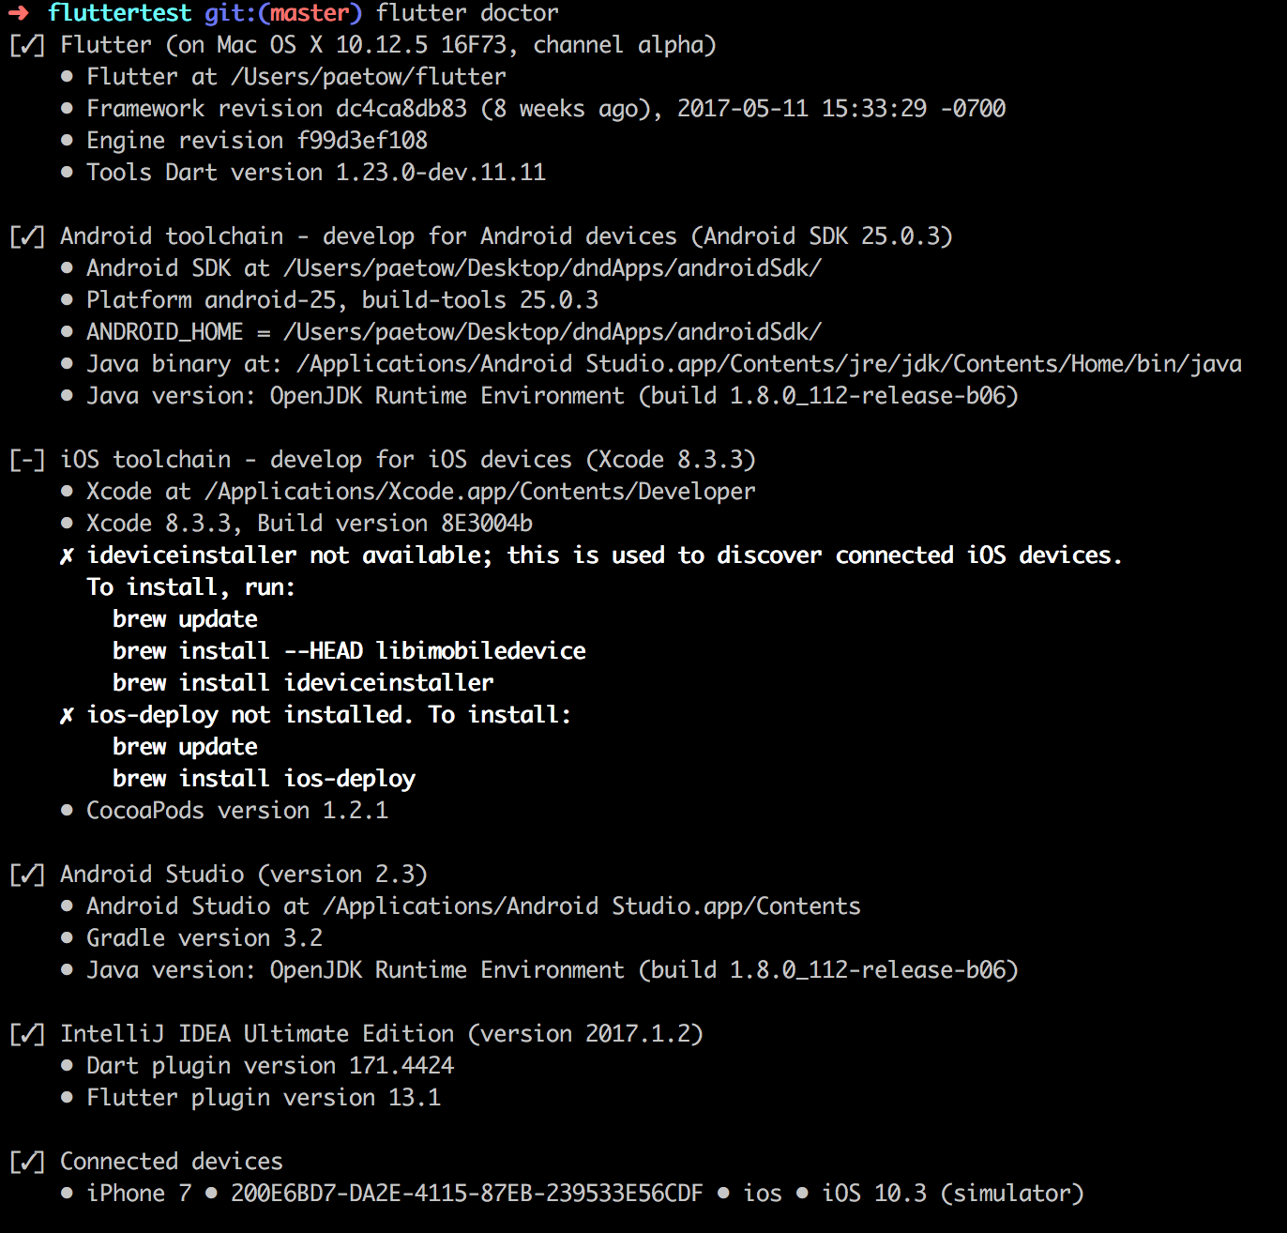
Flutter Doctor
Tool zum Überprüfen der gesamtem Flutter
Toolchain
Zeigt auf einem Blick ob Updates verfügbar sind...
...und wo es Probleme geben könnte.

Slide 10
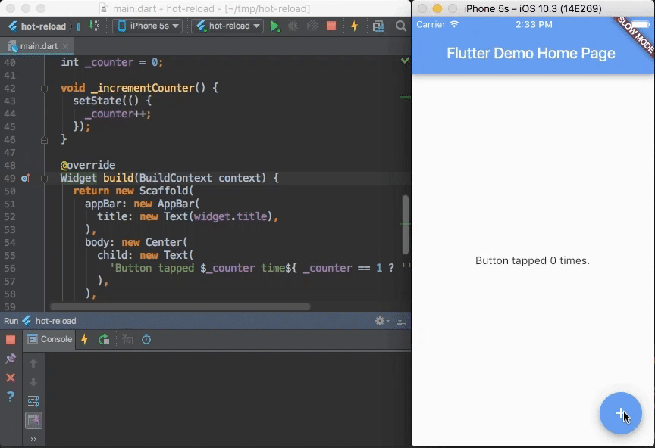
Hot reload
https://flutter.io/getting-started/

Slide 11
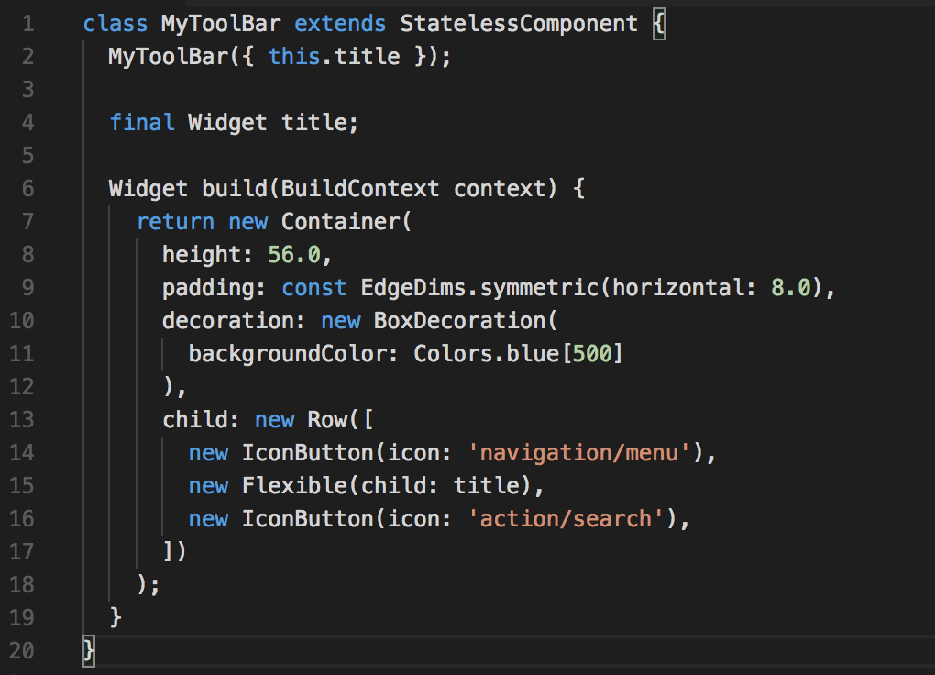
Widgets
Text: stylebares Textfeld
Row, Column: Widget für Layouts in horizontaler (Row) und verticaler (Column) Ausrichtung. (vgl. CSS3 Flexbox).
Stack: -> Widget um mehrere Widgets übereinander darzustellen (FiFo ,absolute positioning).
Container: -> div

Slide 12
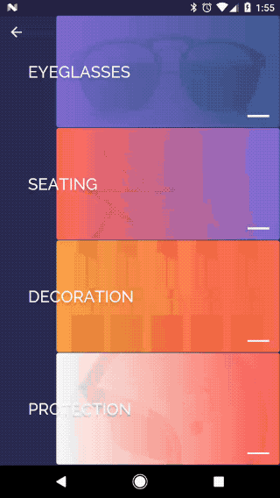
State
Stateless Widgets: Sind statisch und verändern sich nicht z.B. Icon, IconButton & Text erben von StatelessWidget
Stateful Widgets: Widgets mit denen der User interagieren kann z.B. Checkbox, TextField & Slider erben von StateFulWidget Zustand wird in zusätzlichem StateObject gesichert --> .setState() führt zur Neuzeichnung des Widgets

Slide 13
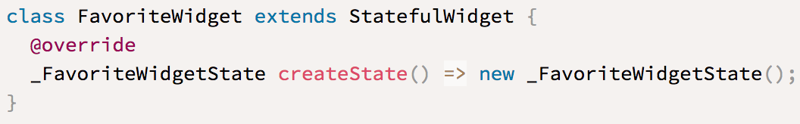
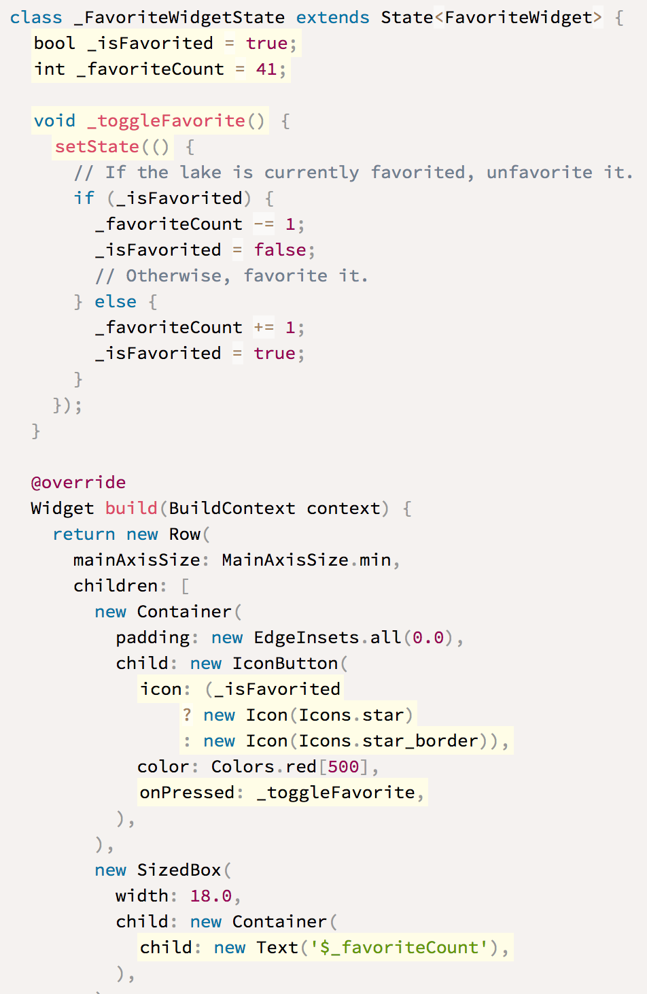
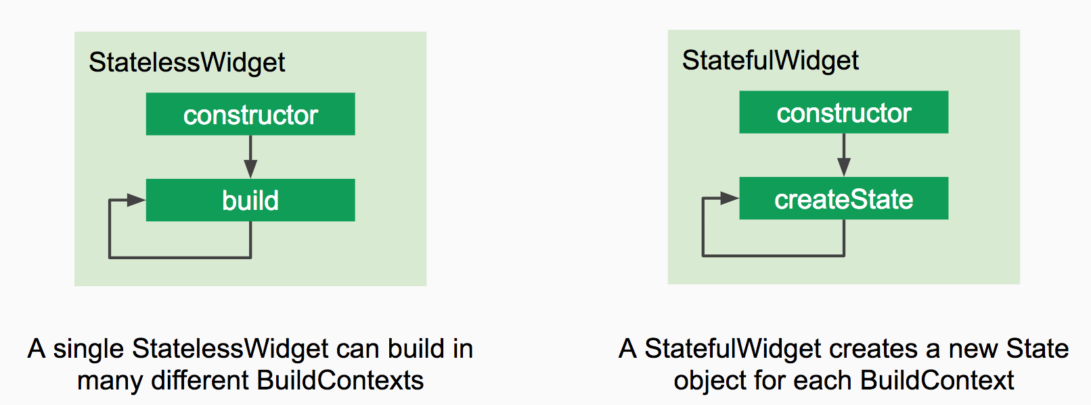
- createState() um den State selbst zu managen
- setState() führt zum Neuzeichnen des Widgets nach Toggle Interaktion
Notes:
The FavoriteWidget class manages its own state, so it overrides createState() to create the State object. The framework calls createState()when it wants to build the widget. In this example, createState() creates an instance of _FavoriteWidgetState, which you’ll implement in the next step. The custom State class stores the mutable information—the logic and internal state that can change over the lifetime of the widget. When the app first launches, the UI displays a solid red star, indicating that the lake has “favorite” status, and has 41 “likes”. The state object stores this information in the _isFavorited and _favoriteCount variables.
The state object also defines the build method. This build method creates a row containing a red IconButton, and Text. The widget usesIconButton, (instead of Icon), because it has an onPressed property that defines the callback method for handling a tap. IconButton also has an icon property that holds the Icon.

Slide 14
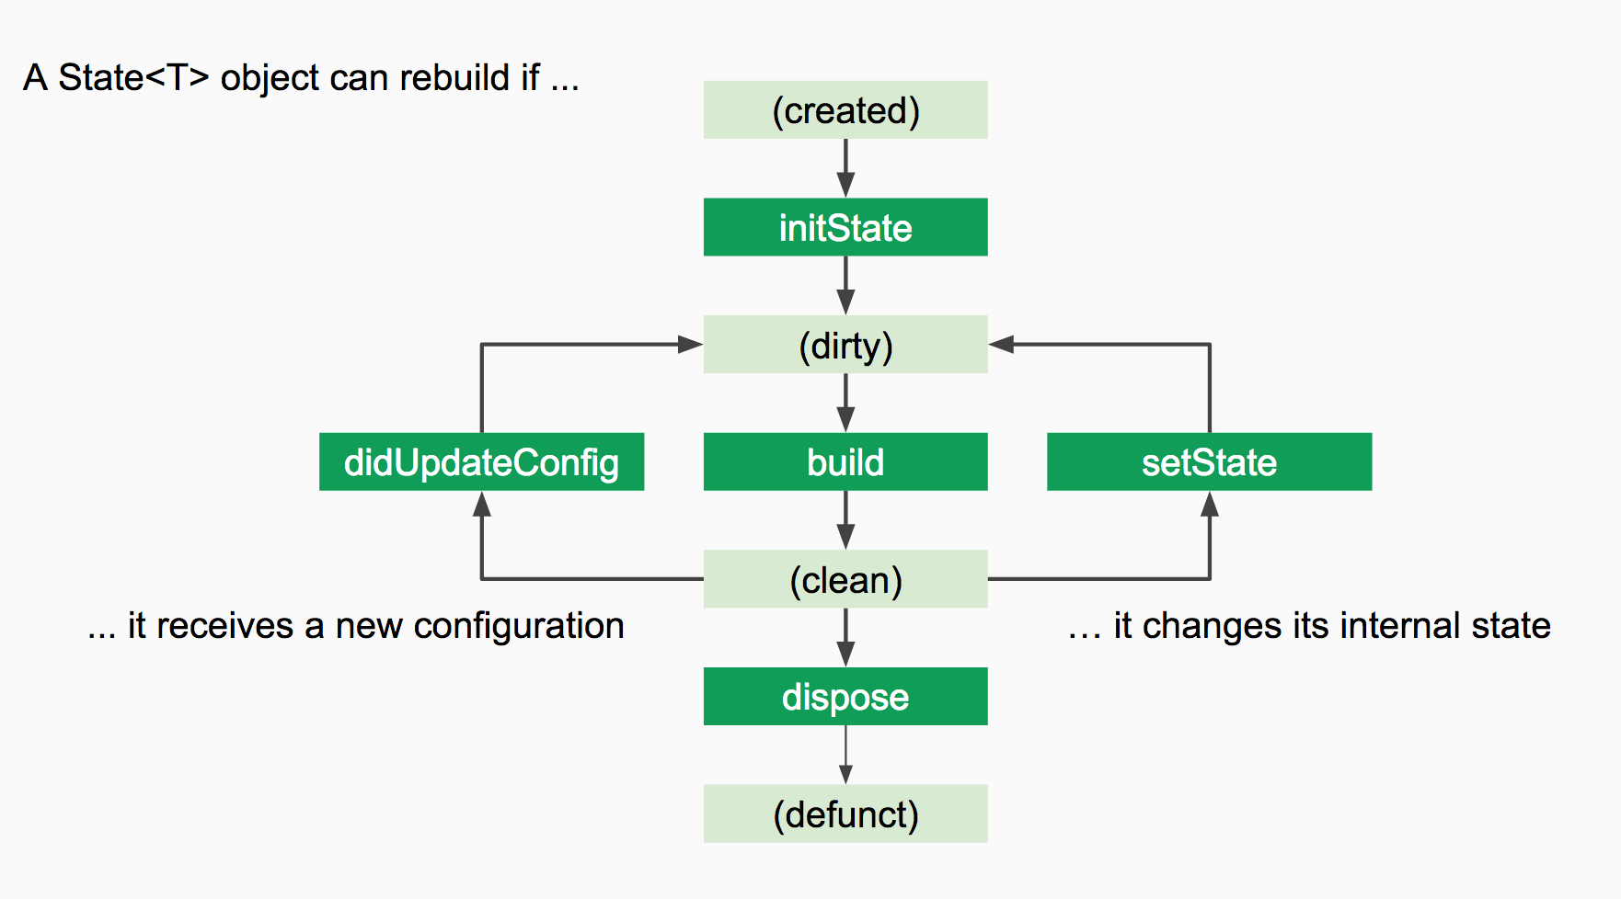
State<T> lifecycle
https://docs.google.com/presentation/d/1cw7A4HbvM_Abv320rVgPVGiUP2msVs7tfGbkgdrTy0I/edit#slide=id.g70d668005_2_22

Slide 15
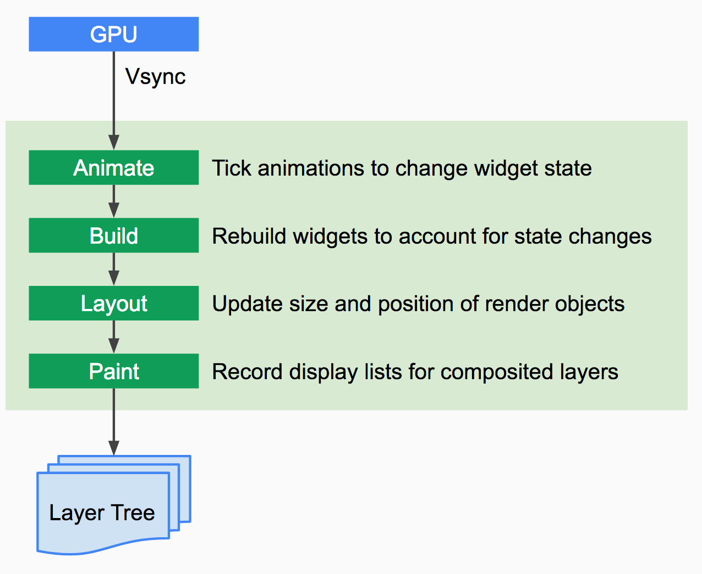
Render Pipeline
https://docs.google.com/presentation/d/1cw7A4HbvM_Abv320rVgPVGiUP2msVs7tfGbkgdrTy0I/edit#slide=id.g70d668005_2_22

Slide 16
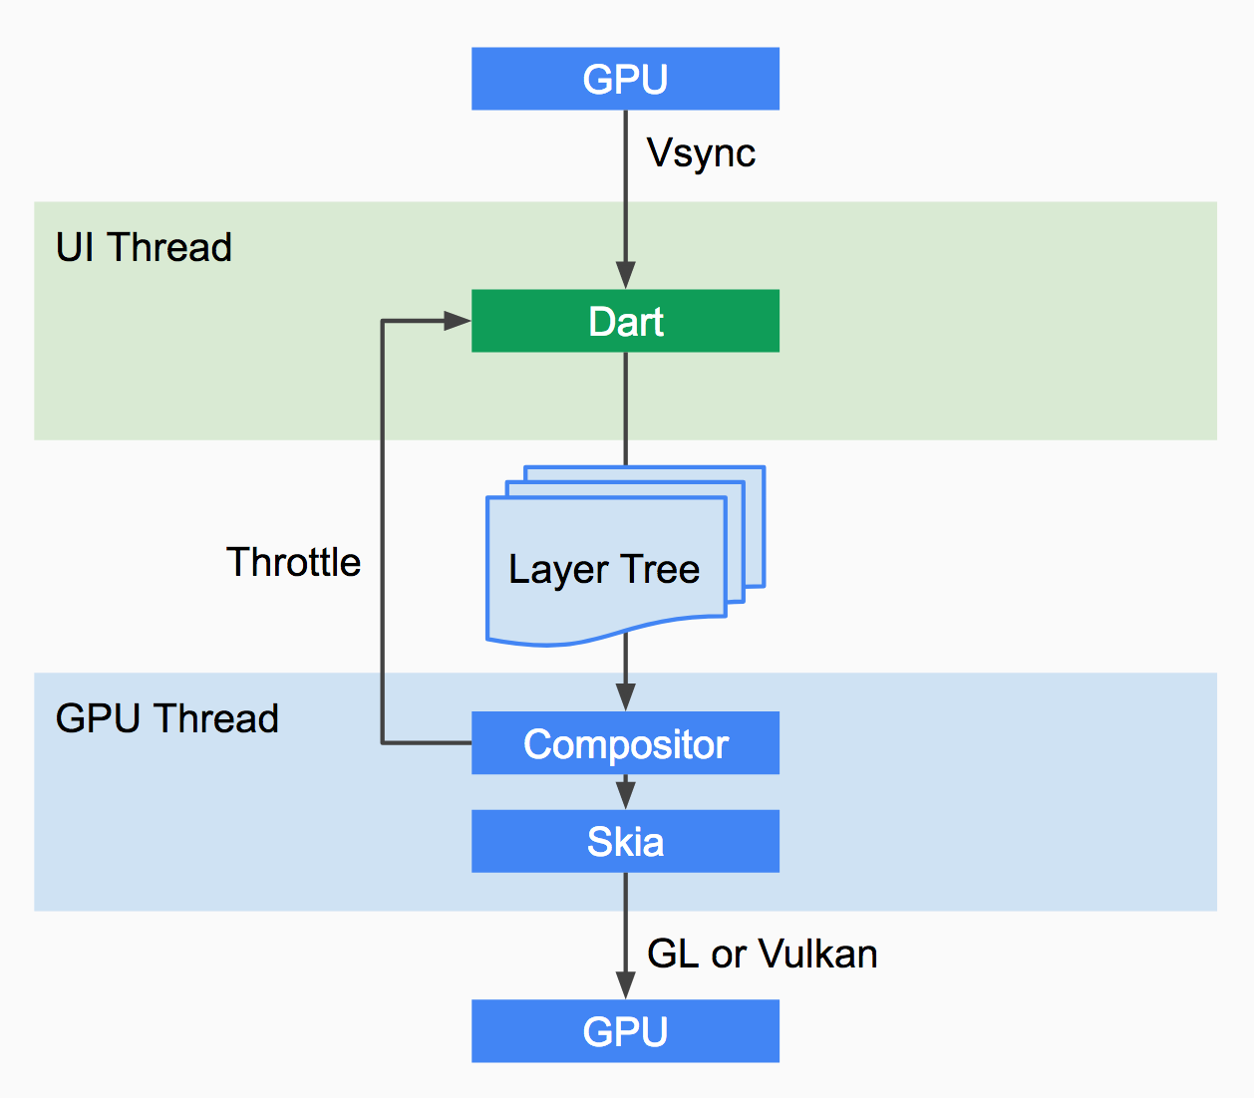
Render Pipeline
https://docs.google.com/presentation/d/1cw7A4HbvM_Abv320rVgPVGiUP2msVs7tfGbkgdrTy0I/edit#slide=id.g70d668005_2_22

Slide 17
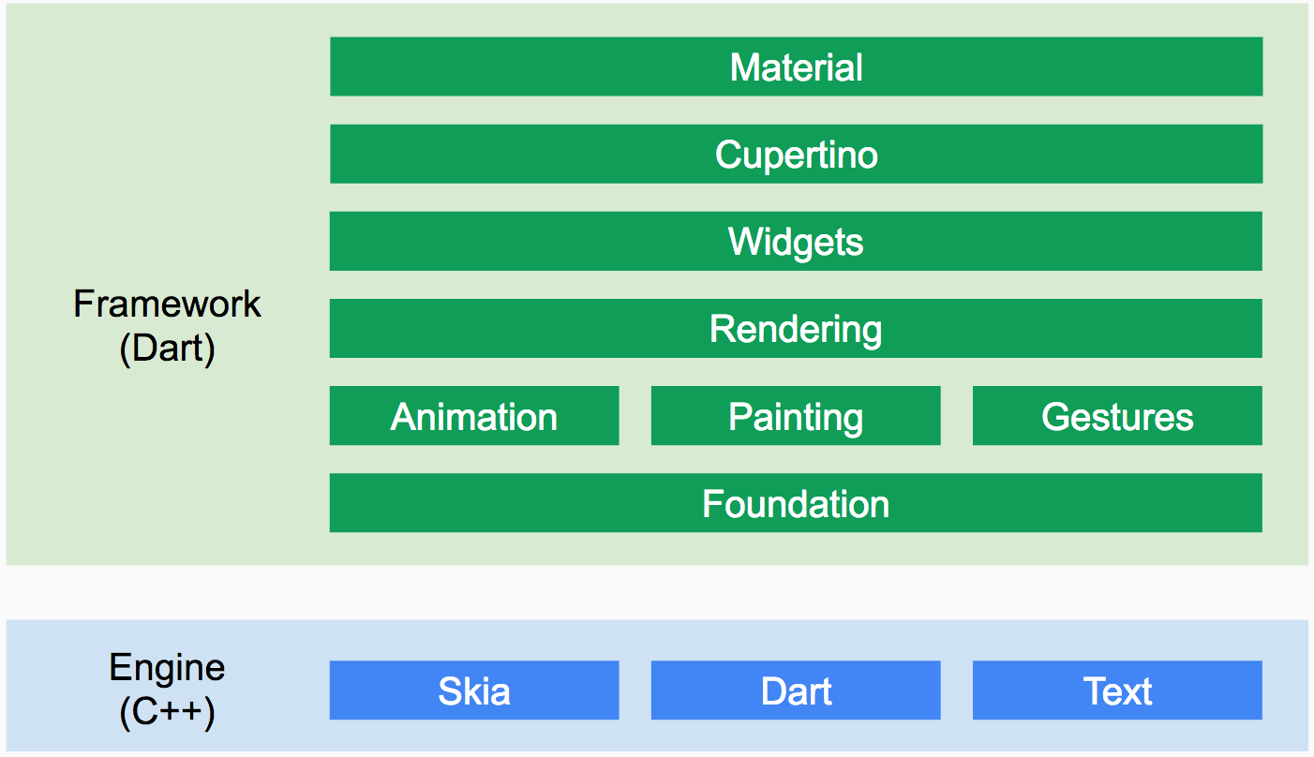
Render Pipeline
https://docs.google.com/presentation/d/1cw7A4HbvM_Abv320rVgPVGiUP2msVs7tfGbkgdrTy0I/edit#slide=id.g70d668005_2_22

